Slide 1
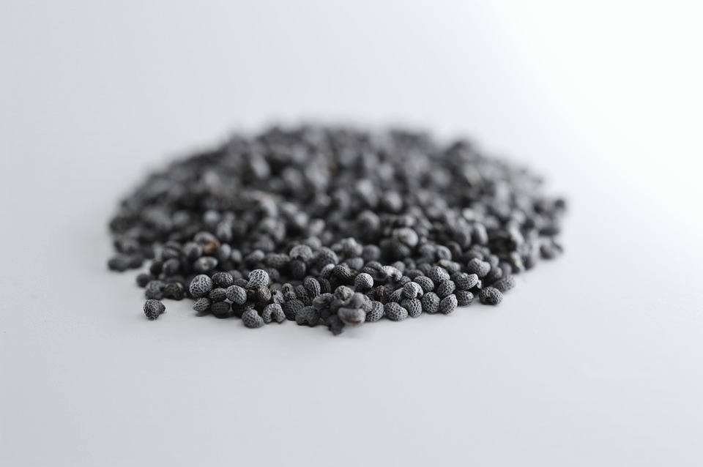
CROP PREDICTION
Akshay Manoj
Data Analytics

Slide 2

INTRODUCTION
This project utilizes machine learning to develop a crop prediction system that analyzes soil composition, climate, and nutrient data to identify the most suitable crops. By providing data-driven insights, the model helps farmers optimize yields, conserve resources, and adapt to climate challenges, promoting sustainable agriculture and enhancing food security.

Slide 3

FEATURES
Nitrogen
Phosphorus
Potassium
Temperature
Humidity
pH_Value
Rainfall

Slide 4

TARGET VALUE
CROP : The target value ‘Crop’ was chosen because the primary objective of this project is to predict the most suitable crop for given soil and environmental conditions, making it the critical output for enabling data-driven agricultural decisions.

Slide 5
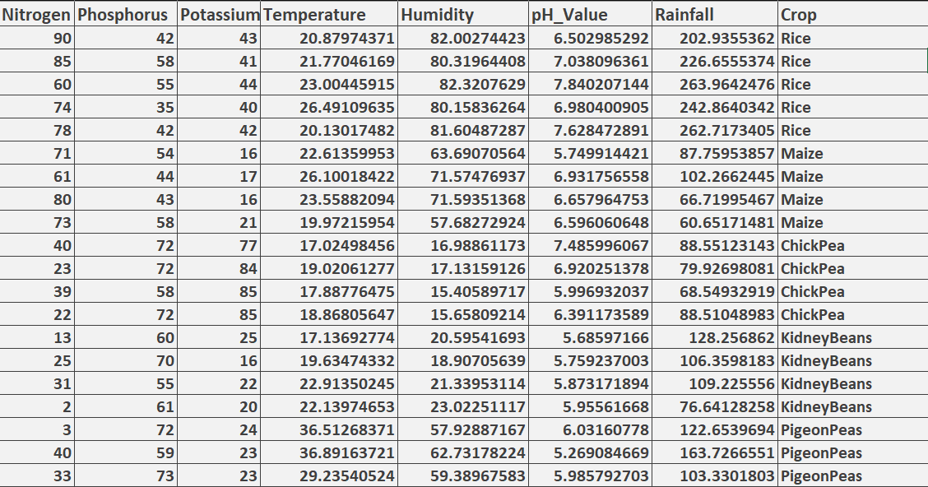
DATASET:

Slide 6
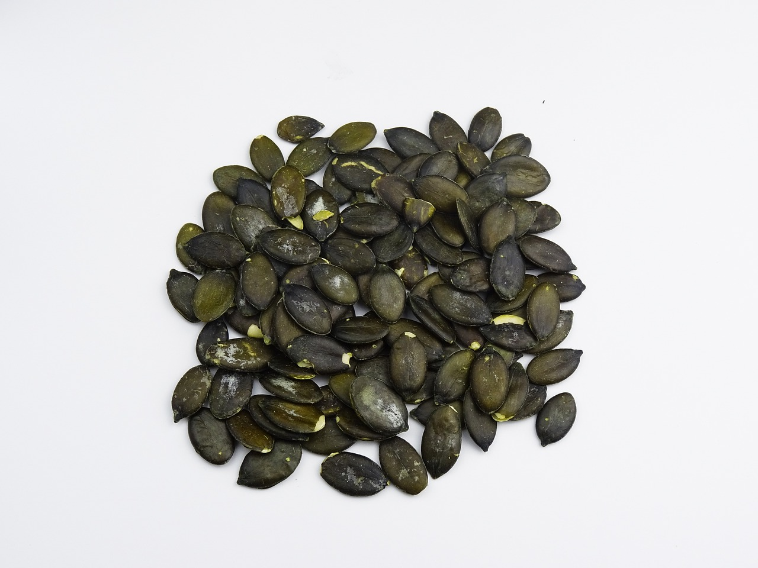
MODEL
Random Forest Classifier: It’s a supervised learning algorithm in machine learning that combines multiple decision trees to predict classified values. Its’s of 2 types Binary Classifier and Multi-Class Classifier. It's a type of ensemble learning method that improves the accuracy and stability of predictions. Multiple decision trees are trained on random subsets of the training data. Each decision tree predicts the target variable. The predictions from individual trees are combined to produce the final prediction.

Slide 7

APPLICATIONS:
Crop Recommendation System : The most suitable crop to plant based on the provided environmental, soil, and climate conditions ,so that it could guide farmers in making data-driven decisions to optimize yield.
Precision Agriculture: Analyzing soil nutrients, pH levels, and climate enables precise decision-making regarding crop rotation and soil treatment, enhancing sustainability and productivity.
Optimized Resource Allocation: Recommendations lead to efficient allocation of resources like water, fertilizers, and pesticides, reducing excess usage, cutting costs, and minimizing environmental impact.
Climate Adaptation: Supports farmers in adapting to climate change by recommending resilient crop varieties suited to various climate scenarios.
Yield Prediction and Planning: Knowing which crops are more likely to succeed under given conditions can aid in yield planning, helping to meet demand and prevent potential food shortages.
Sustainable Land Use Planning: Land use decisions on a regional scale, guiding policymakers to recommend appropriate crops for specific soil and climate conditions across various areas
Crop Switching Strategy: Help farmers adapt to seasonal or market demands.
Multi-Target Crop Prediction: Simultaneously predict crop type and yield quantity.

Slide 8
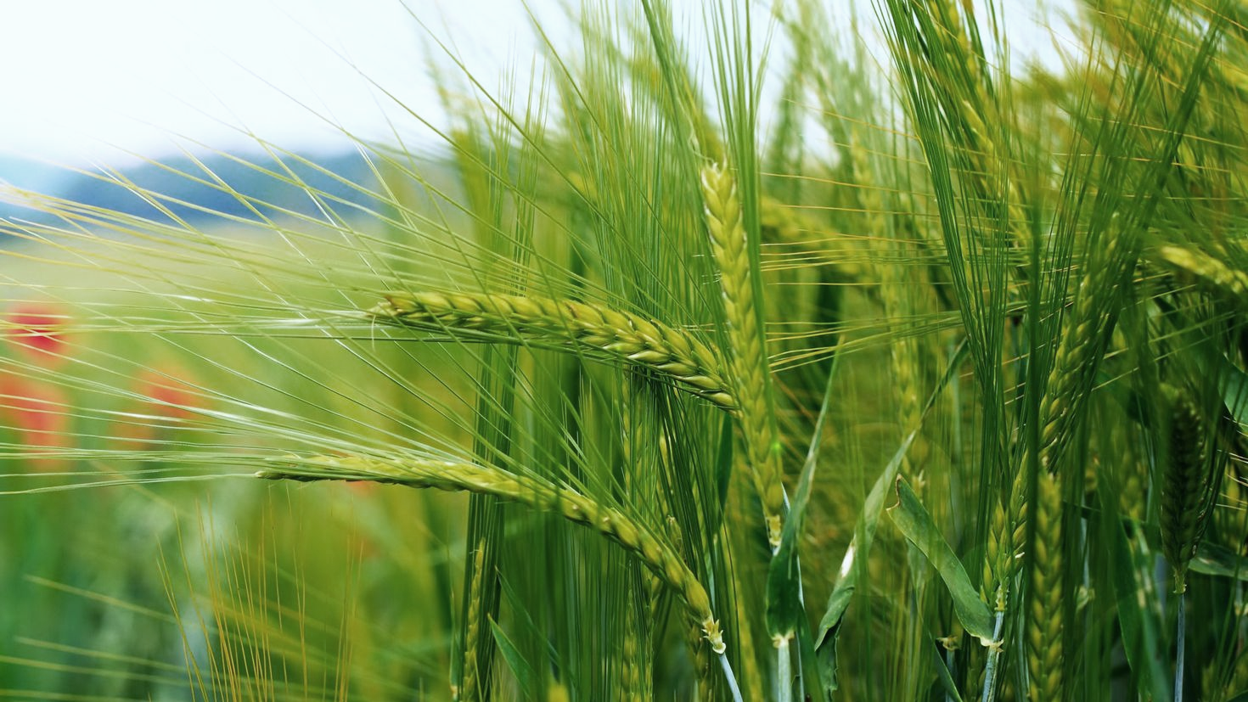
CONCLUSION:
This project has shown how machine learning can drive sustainable and efficient agriculture through targeted crop recommendations. By analyzing environmental and soil data, the model enables precise crop selection, optimizing yield and resource use while supporting resilience to climate changes. Such data-driven insights not only help farmers increase productivity but also foster sustainable practices that benefit both the economy and the environment.

Slide 9
THANK YOU.

